Slide 1

MANAGEMENT OF NATURAL RESOURCES
Use of Forest Resources

Slide 2
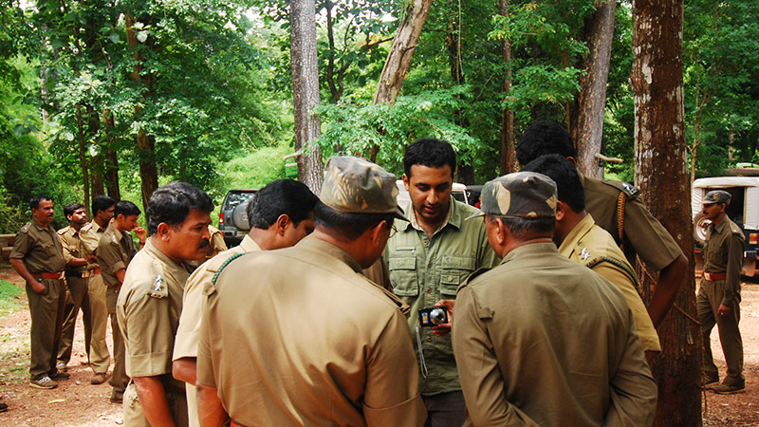


The Forest Department in independent India took over from
the British the control of the forests but local knowledge and local needs continued to be ignored in the management practices.

Slide 3




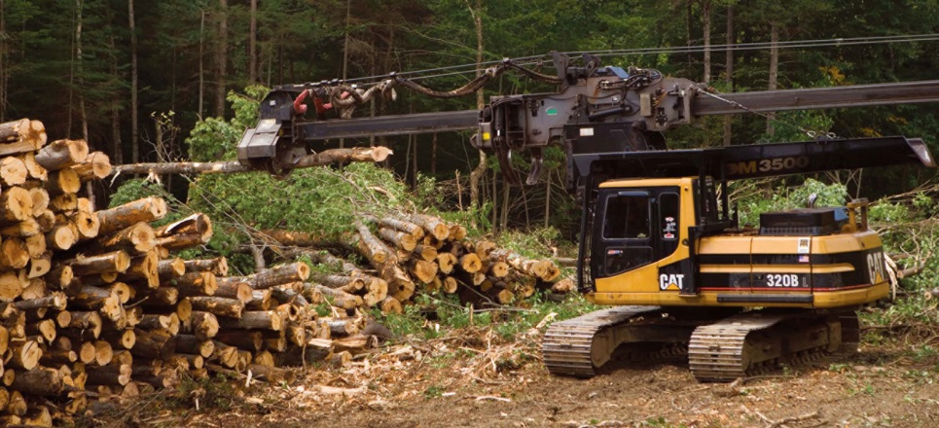
A number of industries are based on forest for example timber, paper, lac and sports equipment.
timber
paper
lac
sports equipment

Slide 4
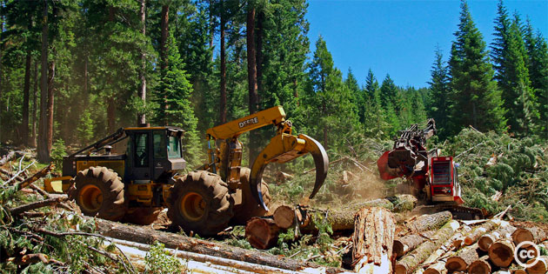
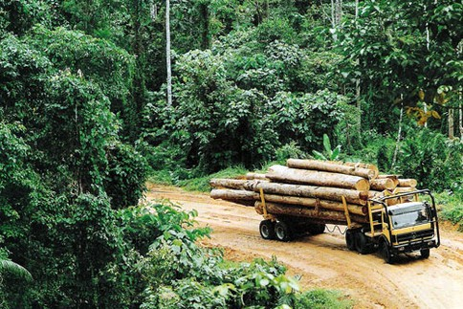


Industries would consider the forest as merely a source of raw material for its factories.

Slide 5


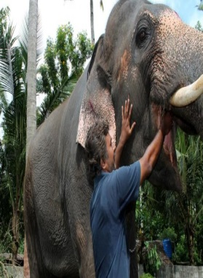
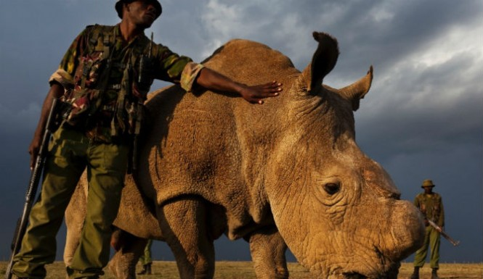
The conservationists were initially taken up with large animals like lions, tigers, elephants and rhinoceros.

Slide 6
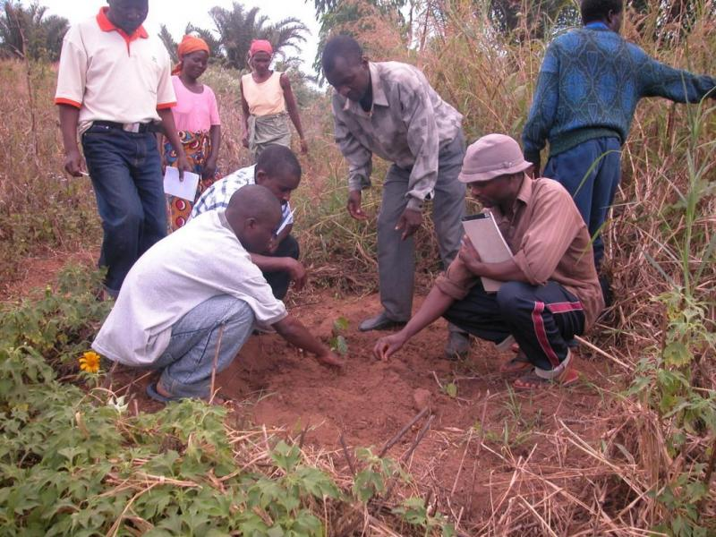
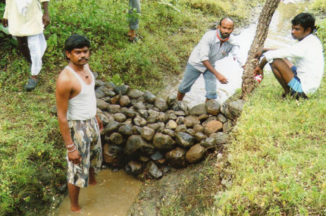
There have been enough instances of local people working traditionally for conservation of forests.

Slide 7
Thank You

